Slide 1
Welcome to GENED 1079 Section!
Notes:
Purpose of disease modeling – meaning of. Why we do. Need simplification.

Slide 2
Agenda
Introductory activity
Section expectations: review document
Modeling epidemics
Group Exercise: Review of β, N, and δ

Slide 3
Agenda
Introductory activity
Section expectations: review document
Modeling epidemics
Group Exercise: Review of β, N, and δ
Notes:
Have students send you photos of themselves over the summer, put together in PowerPoint, have everyone introduce themselves with names, pronouns, what they’re doing in the photo, their house, concentration

Slide 4
Agenda
Introductory activity
Section expectations: review document
Modeling epidemics
Group Exercise: Review of β, N, and δ

Slide 5
Agenda
Introductory activity
Section expectations: review document
Modeling epidemics
Group Exercise: Review of β, N, and δ

Slide 6
Why Model Epidemics?
Discuss: we can already count cases. So why bother building a model?
Take 60 seconds with a neighbor: what could a model tell you that the case counts alone cannot?
Notes:
DISCUSSION PROMPT (2-3 min). Ask before revealing anything: "We can already count cases. Why build a model?" Most students go straight to prediction. Push them toward intervention and complexity — those are the ones they won't produce on their own.
1. PREDICTION / PREPAREDNESS. A model turns today's parameters into tomorrow's caseload: peak timing, peak height, beds, doses, staff. Worth flagging the paradox: models that forecast a severe epidemic often "look wrong" afterward precisely because they prompted the response that averted it.
Source: Lofgren ET, Halloran ME, Rivers CM, et al. Opinion: Mathematical models: a key tool for outbreak response. PNAS 2014;111(51):18095-18096. doi:10.1073/pnas.1421551111
2. INTERVENTION. You cannot randomize a pandemic. The model is the experimental apparatus for policy: quarantine vs. vaccination vs. school closure, and how to allocate a scarce dose supply. Connect this directly to the SIR spreadsheet later in section — changing beta, N, or delta IS a policy lever (masks/condoms lower beta, distancing lowers N, treatment raises delta).
Sources: Heesterbeek H, Anderson RM, Andreasen V, et al. Modeling infectious disease dynamics in the complex landscape of global health. Science 2015;347(6227):aaa4339. doi:10.1126/science.aaa4339 | Grassly NC, Fraser C. Mathematical models of infectious disease transmission. Nature Reviews Microbiology 2008;6:477-487. doi:10.1038/nrmicro1845
3. COMPLEXITY. Transmission is nonlinear: every infection depletes the susceptible pool, so outputs are not proportional to inputs. This is exactly why R0 = beta*N/delta is worth deriving, and where the herd immunity threshold 1 - 1/R0 comes from — you never have to reach everyone. If there is time, the counterintuitive case: partial rubella vaccination raises the average age of infection and, in persistently high-transmission settings, can increase congenital rubella syndrome. That result is invisible without a model.
Sources: Grassly & Fraser 2008 (above) | Winter AK, et al. The impact of rubella vaccine introduction on rubella infection and congenital rubella syndrome: a systematic review of mathematical modelling studies. PMC7912610
4. EVALUATION. Models supply the counterfactual for retrospective attribution — what would have happened otherwise. The COVID vaccine figure: 19.8 million deaths averted in year one when benchmarked against excess-mortality estimates (14.4 million against reported COVID deaths). Note the correction published in 2023.
Source: Watson OJ, Barnsley G, Toor J, Hogan AB, Winskill P, Ghani AC. Global impact of the first year of COVID-19 vaccination: a mathematical modelling study. Lancet Infect Dis 2022;22(9):1293-1302. doi:10.1016/S1473-3099(22)00320-6
THE HONEST CAVEAT (raise it yourself if a student doesn't). Early in an outbreak, data are scarce and forecasts carry wide uncertainty; the value of the model is often in making assumptions explicit and comparable, not in the point estimate. "All models are wrong, some are useful."
Source: Metcalf CJE, Lessler J. Opportunities and challenges in modeling emerging infectious diseases. Science 2017;357(6347):149-152. doi:10.1126/science.aam8335
TO REVEAL THE FOUR REASONS ONE AT A TIME: select the body text box, Animations > Appear, then Effect Options > By Paragraph.

Slide 7
Why Model Epidemics?
Discuss: we can already count cases. So why bother building a model?
Take 60 seconds with a neighbor: what could a model tell you that the case counts alone cannot?
Prediction — see the epidemic before it arrives: how big, how fast, how many at once.
Ebola forecasts in 2014 drove the scale and timing of the international response (Lofgren et al., PNAS 2014).
Intervention — compare control strategies we can never ethically or practically randomize.
Close schools, or vaccinate the elderly first? A model is the only counterfactual we get.
Complexity — transmission is not straightforward. Imagine a network of people.
We will see this a little later. Can help answer if an outbreak will burnout or become epidemic.
Evaluation — put a number on what a policy actually bought, after the fact.
COVID-19 vaccines are estimated to have averted 19.8 million deaths in their first year.
Resources — see where resources are most needed.
Hospital beds, ventilators, PPE during COVID-19.
What follows today — β, c, δ is machinery for answering “what if?”. With more to come Thursday and next week.
Notes:
DISCUSSION PROMPT (2-3 min). Ask before revealing anything: "We can already count cases. Why build a model?" Most students go straight to prediction. Push them toward intervention and complexity — those are the ones they won't produce on their own.
1. PREDICTION / PREPAREDNESS. A model turns today's parameters into tomorrow's caseload: peak timing, peak height, beds, doses, staff. Worth flagging the paradox: models that forecast a severe epidemic often "look wrong" afterward precisely because they prompted the response that averted it.
Source: Lofgren ET, Halloran ME, Rivers CM, et al. Opinion: Mathematical models: a key tool for outbreak response. PNAS 2014;111(51):18095-18096. doi:10.1073/pnas.1421551111
2. INTERVENTION. You cannot randomize a pandemic. The model is the experimental apparatus for policy: quarantine vs. vaccination vs. school closure, and how to allocate a scarce dose supply. Connect this directly to the SIR spreadsheet later in section — changing beta, N, or delta IS a policy lever (masks/condoms lower beta, distancing lowers N, treatment raises delta).
Sources: Heesterbeek H, Anderson RM, Andreasen V, et al. Modeling infectious disease dynamics in the complex landscape of global health. Science 2015;347(6227):aaa4339. doi:10.1126/science.aaa4339 | Grassly NC, Fraser C. Mathematical models of infectious disease transmission. Nature Reviews Microbiology 2008;6:477-487. doi:10.1038/nrmicro1845
3. COMPLEXITY. Transmission is nonlinear: every infection depletes the susceptible pool, so outputs are not proportional to inputs. This is exactly why R0 = beta*N/delta is worth deriving, and where the herd immunity threshold 1 - 1/R0 comes from — you never have to reach everyone. If there is time, the counterintuitive case: partial rubella vaccination raises the average age of infection and, in persistently high-transmission settings, can increase congenital rubella syndrome. That result is invisible without a model.
Sources: Grassly & Fraser 2008 (above) | Winter AK, et al. The impact of rubella vaccine introduction on rubella infection and congenital rubella syndrome: a systematic review of mathematical modelling studies. PMC7912610
4. EVALUATION. Models supply the counterfactual for retrospective attribution — what would have happened otherwise. The COVID vaccine figure: 19.8 million deaths averted in year one when benchmarked against excess-mortality estimates (14.4 million against reported COVID deaths). Note the correction published in 2023.
Source: Watson OJ, Barnsley G, Toor J, Hogan AB, Winskill P, Ghani AC. Global impact of the first year of COVID-19 vaccination: a mathematical modelling study. Lancet Infect Dis 2022;22(9):1293-1302. doi:10.1016/S1473-3099(22)00320-6
THE HONEST CAVEAT (raise it yourself if a student doesn't). Early in an outbreak, data are scarce and forecasts carry wide uncertainty; the value of the model is often in making assumptions explicit and comparable, not in the point estimate. "All models are wrong, some are useful."
Source: Metcalf CJE, Lessler J. Opportunities and challenges in modeling emerging infectious diseases. Science 2017;357(6347):149-152. doi:10.1126/science.aam8335
TO REVEAL THE FOUR REASONS ONE AT A TIME: select the body text box, Animations > Appear, then Effect Options > By Paragraph.

Slide 8

Modeling Epidemics: Refresher
Prevalence: what share of people have the disease at a point in time?
$$Prevalence= \frac{\# infected}{\# in the population}$$
Notes:
Take some time to explain “a point in time”, because people were confused about this on the PSET in previous years.
Example of a point in time: in the PSET you will be asked the prevalence on 1/1/YYYY – think about this as the prevalence of a disease in the moment that the clock strikes midnight in the new year.

Slide 9

Modeling Epidemics: Refresher
Incidence: what share of people who are susceptible to contracting the disease become infected by it in a period of time?
$$Incidence= \frac{\# newly infected}{\# susceptible}$$
Notes:
Period of time = over a day, week, in one month, during a quarter
Remove infected and died from population amount to get susceptible pop.
Can walk through examples of who goes in the denominator/numerator. Examples:
- Someone sick before the defined time period does not go in the numerator or denominator
- Someone who becomes sick within the time period goes in both the numerator and the denominator
- Someone who never was and never becomes sick goes in the denominator, but not the numerator

Slide 10
Modeling Epidemics: Refresher
There are 100 people in a population. 10 are already sick. If another 15 get sick today and no one recovers, what will the prevalence and the incidence be at the end of the day?
Prevalence:
Incidence:
Notes:
Ask if one person can volunteer to share the prevalence, and another volunteer can share the incidence

Slide 11
Modeling Epidemics: Refresher
There are 100 people in a population. 10 are already sick. If another 15 get sick today and no one recovers, what will the prevalence and the incidence be at the end of the day?
Prevalence: 25 / 100 = 0.25
Incidence:
Notes:
For prevalence, think of the moment in time as the very end of tomorrow
# in population = 100
# infected by end of tomorrow = 25
Prevalence = 25/100 = .25

Slide 12
Modeling Epidemics: Refresher
There are 100 people in a population. 10 are already sick. If another 15 get sick today and no one recovers, what will the prevalence and the incidence be at the end of the day?
Prevalence: 25 / 100 = 0.25
Incidence: 15 / 90 = 0.166
Notes:
For incidence, think of time period as between today and tomorrow (a day)
# newly infected = 15
# susceptible = total population – those already infected = 90
Incidence: 15/90 = 0.1666

Slide 13
Modeling Epidemics: Refresher
There are 100 people in a population. 10 are already sick. If another 15 get sick today and no one recovers, what will the prevalence and the incidence be today?
Prevalence: 25 / 100 = 0.25
Incidence: 15 / 90 = 0.166
Why are the denominators different?

Slide 14
Modeling Epidemics: Key Abbreviations
S:
I:
R:
N:
s:
i:
r:
𝛃:
N or c:
𝛅:
Number susceptible
Number infected
Number recovered or deceased
Total population size (N = S + I + R)
Percentage susceptible (s = S/N)
Percentage infected (i = I/N)
Percentage recovered or deceased (r = R/N)
Probability that contacting an infectious source transmits infection
Number contacts with potential source of infection
Rate of recovery or death
Notes:
Explain that the source of infection could be an infected person, or it could be other carriers – mosquitoes, contaminated water, etc.
Be clear that an encounter that counts for N is a potential encounter with the infection, i.e. an encounter with a carrier of the infection.
We often think of N as the population.
Beta is the effective contact rate – contact rate x transmission probability
N means humans/mosquitos/wells, rather than infected humans / infected mosquitos / infected wells

Slide 15
Modeling Epidemics: Refresher
There are 100 people in a population. 10 are already sick. If another 15 get sick today and no one recovers, what will S, I, and R equal at the end of the day?
S (Number susceptible) =
I (Number infected) =
R (Number recovered / deceased) =
Notes:
Again, calculate for the end of tomorrow

Slide 16
Modeling Epidemics: Refresher
There are 100 people in a population. 10 are already sick. If another 15 get sick today and no one recovers, what will S, I, and R equal at the end of the day?
S (Number susceptible) = 100 – 10 – 15 = 75
I (Number infected) =
R (Number recovered / deceased) =

Slide 17
Modeling Epidemics: Refresher
There are 100 people in a population. 10 are already sick. If another 15 get sick today and no one recovers, what will S, I, and R equal at the end of the day?
S (Number susceptible) = 100 – 10 – 15 = 75
I (Number infected) = 10 + 15 = 25
R (Number recovered / deceased) =

Slide 18
Modeling Epidemics: Refresher
There are 100 people in a population. 10 are already sick. If another 15 get sick today and no one recovers, what will S, I, and R equal at the end of the day?
S (Number susceptible) = 100 – 10 – 15 = 75
I (Number infected) = 10 + 15 = 25
R (Number recovered / deceased) = 0

Slide 19
Agenda
Introductory activity
Section expectations: review document
Modeling epidemics
Group Exercise: Review of β, N, and δ

Slide 20
Group Exercise: Review of β, N, and δ
Preview
Part 1: When would you expect β, N, and δ to be high or low?
Part 2: Pick a disease within your group’s illness category and research true values of β, N, δ, incidence, and prevalence.
Illness categories (and how illness spreads)
Group 1 - Waterborne illnesses (fecal-to-oral)
Group 2 - Sexually transmitted diseases (person-to-person)
Group 3 - Mosquito-borne diseases (person-to-mosquito-to-person)
Notes:
Explain the bones of the assignment and disease groups we’ll focus on and how they spread, but don’t break out into groups yet.

Slide 21
Group Exercise: Review of β, N, and δ
Part 1: When would you expect β, N, and δ to be high or low?
β: “Likelihood of getting infected when in contact with source of infection”
N: “Average number of contacts with potential source of infection”
δ: “Rate of recovery from infection or dying from infection”
Group 1 (Waterborne illnesses)
Group 2 (Sexually transmitted infections)
Group 3 (Mosquito-borne diseases)
Nominate the person with the next upcoming birthday to share out
Notes:
Assign students to the groups. Ask them to discuss, for each type of disease, under what circumstances they would expect beta, N or delta to be high vs. low. Have them discuss for ~5-10 minutes.
Have them assign a spokesperson based on who has the next upcoming birthday and report out to the class at the end.

Slide 22
Group Exercise: Review of β, N, and δ
When would you expect to be high or low: β
β: “Likelihood of getting infected when in contact with source of infection”
Group 1 (Waterborne illnesses)
  Higher when: people do not boil or filter drinking water
  Lower when: individuals are vaccinated (e.g., hepatitis A)
Group 2 (Sexually transmitted infections)
  Higher when: people do not use condoms
  Lower when: people use condoms, are vaccinated (e.g., HPV vaccine), and/or use prophylactic treatments (e.g. HIV PrEP)
Group 3 (Mosquito-borne diseases)
  Higher when: food is left uncovered or there is standing water
  Lower when: people use prophylactic treatments (e.g., chloroquine for malaria, new malaria vaccines)

Slide 23
Group Exercise: Review of β, N, and δ
When would you expect to be high or low: N
N: “Average number of contacts with source of infection”
Group 1 (Waterborne illnesses)
  Higher with: poor sanitation or hygiene (e.g., drinking water contaminated with feces)
  Lower with: good water sanitation/hygiene
Group 2 (Sexually transmitted infections)
  Higher when: people have more sexual partners, do not get regular STD testing (they may think they are healthy leading to more risky behavior)
  Lower when: people have fewer sexual partners, are tested regularly
Group 3 (Mosquito-borne diseases)
  Higher with: tropical and subtropical climates, higher temperatures, rainfall
  Lower with: bed nets, air conditioning, bug repellants, loose long-sleeved clothing, improved sanitation

Slide 24
Group Exercise: Review of β, N, and δ
When would you expect to be high or low: δ
δ: “Rate of recovery from infection or dying from infection”
Group 1 (Waterborne illnesses)
  Lower when: bacterial diseases are treated with antibiotics
  Remember that those who are infected are not directly transmitting to others, but they may indirectly transmit (e.g., poor hygiene, fecal-to-oral transmission)
Group 2 (Sexually transmitted infections)
  Lower when: people are tested frequently and treated when diagnosed
Group 3 (Mosquito-borne diseases)
  Lower when: people are effectively treated or if people die quickly
  Remember that mosquitos are transmitting the disease, so clearing the disease faster may not have much direct effect on disease transmission
Notes:
Be sure to note that delta is made up of two components: the recovery rate and the death rate, thus whether delta is high or low depends on whether both elements are high or low. Maybe have students give examples of what would make likelihood of dying lower
Also note that across all illnesses
Death rate is high when disease is severe and few treatments are available, and low if the disease is not as severe and there are effective treatments available
Recovery rate is high when there are effective treatments that people can access and afford, and low if people are not getting tested and/or treatments are not effective/accessible/affordable

Slide 25
Resources for Infectious Diseases Around the World:
Our world in data (Many infectious diseases): https://ourworldindata.org/coronavirus
NYTimes (Covid): https://www.nytimes.com/interactive/2021/us/covid-cases.html
CDC (Covid): https://covid.cdc.gov/covid-data-tracker/#datatracker-home
CDC (Mumps): https://www.cdc.gov/mumps/outbreaks.html
Johns Hopkins (Covid): https://coronavirus.jhu.edu/map.html

Slide 26
Group Exercise: Review of β, N, and δ
Part 2: Pick a disease in your illness category and research the true values of:
β
N
δ
Prevalence
Incidence
Nominate the person with the next upcoming birthday to share out
Notes:
Again, have groups research and discuss for ~5-10 minutes. Suggest they pick a specific region or country.

Slide 27
Agenda
Introductory activity
Section expectations: review document
Modeling epidemics
Group Exercise: Review of β, N, and δ
Review of SIR spreadsheet – Move to section 2 to start class.

Slide 28
When will disease spread? - Refresher
Change in = Inflow - Outflow
prevalence
β ∙ N ∙ s ∙ i - δ ∙ i
At the start of an epidemic, s ≈ 1. Thus, the change in prevalence is positive if:
β ∙ N / δ ≡ R₀ > 1
Transmission
Recover/remove
R-naught
Notes:
Highlight that not all components of equation are fixed, e.g., beta is influenced by both the frequency of contact and the chance of transmission during each contact
Key policy question - how to reduce disease spread by reducing Beta and/or N
If inflow > outflow -> there will be an epidemic
If inflow < outflow -> disease will “die” overtime

Slide 29
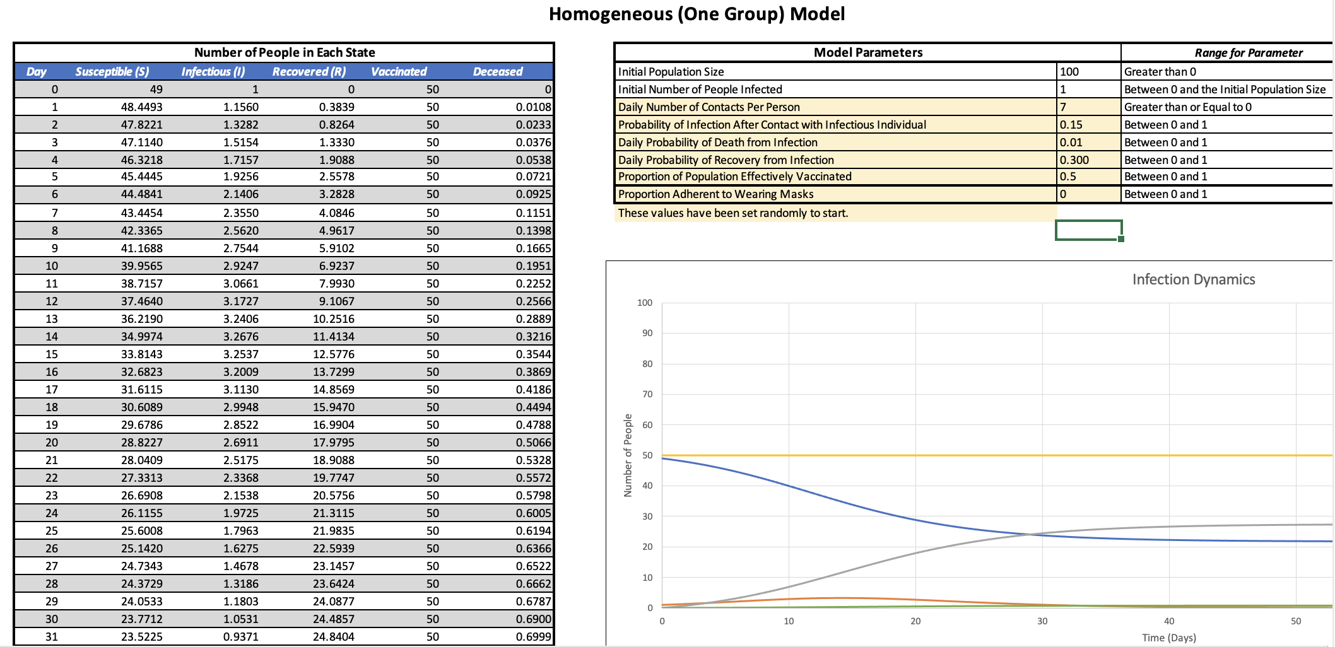
Review of SIR Spreadsheet
Change parameters here
Calculate incidence/prevalence
Visualize disease dynamics
Notes:
How to change y-axis
Concepts students struggled with in class [note from Marema – this is from prior years, so we will need to update after the 9/9 Lecture]:
Delta (is equal to rate of death + rate of recovery, not just rate of recovery)
How to figure out how many people have ever gotten the disease at day 75 (explain why is it we only look at row 75, why not add across each day)
70% efficacy of masks is built into the model (read notes to the right side)

Slide 30
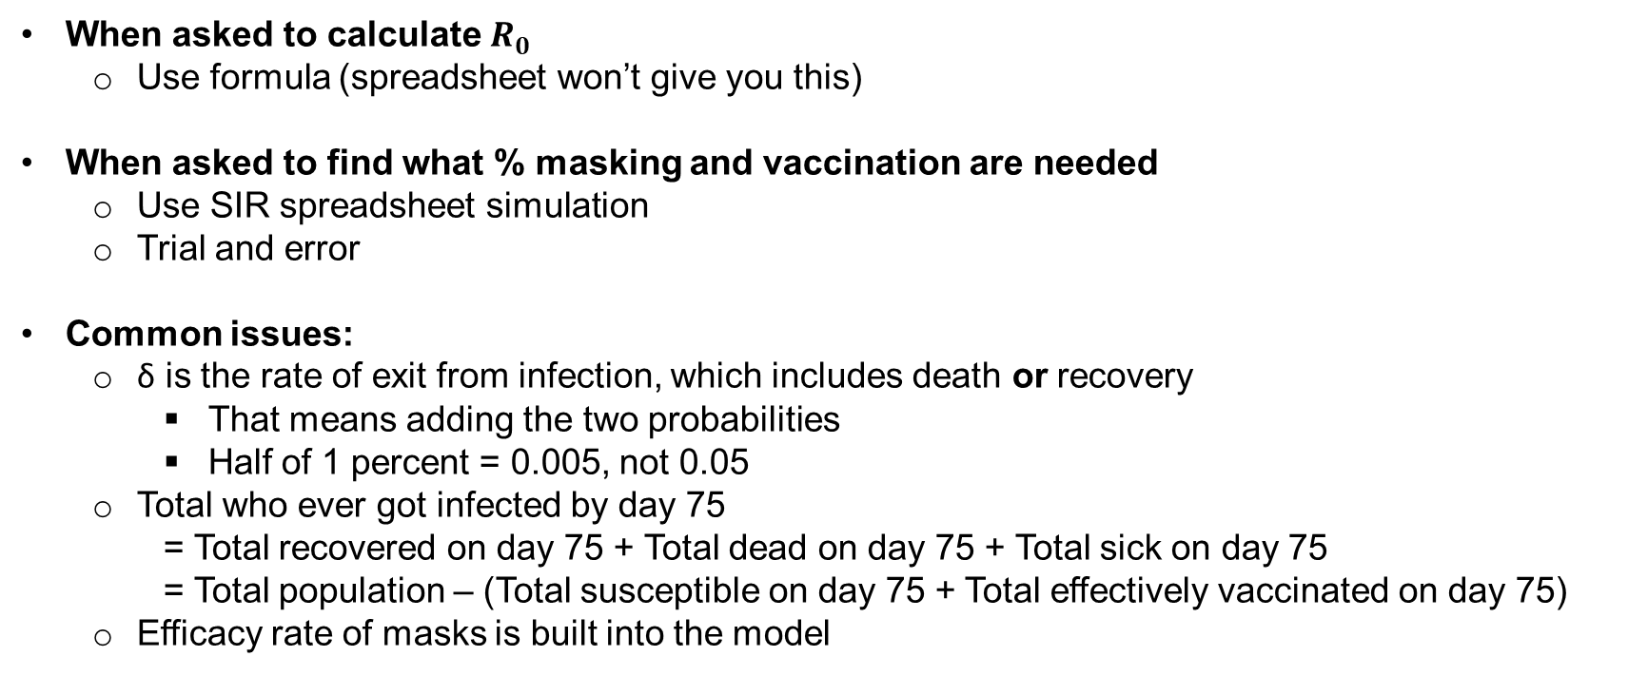
Review of 9/9 Class Activity
When asked to calculate $R_{0}$
  Use formula (spreadsheet won’t give you this)
When asked to find what % masking and vaccination are needed
  Use SIR spreadsheet simulation
  Trial and error
Common issues:
  δ is the rate of exit from infection, which includes death or recovery
    That means adding the two probabilities
    Half of 1 percent = 0.005, not 0.05
  Total who ever got infected by day 75
    = Total recovered on day 75 + Total dead on day 75 + Total sick on day 75
    = Total population – (Total susceptible on day 75 + Total effectively vaccinated on day 75)
  Efficacy rate of masks is built into the model

Slide 31
Reminders
Unit assignment 1 given out Tuesday, September 8th
We will collect Unit 1 preferences (Harvard/Louisiana) due Tuesday, September 15th at 5pm EST
Problem Set 1 handed out Thursday, September 10th
Problem Set 1 due Monday, September 21st at 5pm EST
Unit 1 assignment due Friday, September 25 at 5pm EST

